Slide 1
Disease Management System
"Optimizing Healthcare Ecosystems: A Comprehensive Disease Management System for Seamless Patient Care and Enhanced Administrative Efficiency."
Chinmay Mahesh Deshpande
Amey Umesh Satwe
Shreya Jayesh Thakur

Slide 2
problem Definition and solution
Our Disease Management System simplifies healthcare procedures by centralizing information for more efficient patient care, improved communication, and functioning control. It tackles issues such as healthcare access, insurance claim processing, NGO assistance, and complete treatment monitoring. It provides with:
Problem with centralized information management:
Problem: Disparate healthcare information leads to inefficiency.
Solution: The system centralizes patient records to allow for more efficient communication.
Access to Healthcare Services:
Problem: Patients have difficulty accessing services and managing their records.
Solution: The system provides quick access to hospitals and medical records.
Patient-Doctor Interactions that Work:
Problem: The lack of simplified communication impedes care.
Solution: The system allows doctors to access patient records for improved communication.
Reporting Oversight and Planning:
Problem: Reporting authority have a difficult time dealing with real-time healthcare data.
Solution: A reporting dashboard gives information to aid in successful planning.
Insurance Claim Processing:
Problem: Delays have an influence on timely recovery of expenditures.
Solution: The insurance admin dashboard automates claim acceptance for faster answers.

Slide 3
stakeholders
System Admin
System admin holds the highest hierarchy, managing login credentials and overseeing the addition of entities like patients, doctors, hospitals, and various administrators in the Disease Management System.
Patient
Patients can access nearby hospitals, medical history, and manage finances by adding to their wallet. They can also raise requests to NGOs, buy or claim insurance, ensuring comprehensive control over their healthcare journey.
Doctor
Doctors can view patient records, track encounters, and input diagnoses in their dashboard, facilitating effective and informed medical decision-making for each patient.
Report
Report dashboard provides a comprehensive overview, showcasing the number of active patients, total hospitals, and doctors. It offers detailed insights into the healthcare landscape to aid in strategic decision-making.
Insurance
Insurance admin dashboard handles the approval of insurance claims and facilitates patient requests, ensuring a smooth process for patients to buy or claim insurance benefits.

Slide 4
stakeholders
Pharmacy
Pharmacy dashboard offers a detailed medicine list for patients and associated costs, ensuring efficient management of medication-related information for both the patient and pharmacy.
NGO
NGO admin dashboard manages patient details, balances, and sponsorship decisions, enabling them to support patients in need by overseeing and sponsoring medical bills.
Lab Admin
Lab admin dashboard captures the interactions between doctors and patients, treatment statuses, and the total amount to be paid, ensuring accurate documentation and streamlined communication.
Treatment Unit
Treatment unit dashboard provides a comprehensive view of patient details, encounters, lab statuses, and treatment progress, aiding healthcare professionals in delivering personalized and effective care.

Slide 5
usecases
Use cases:
Patient Management:
Scenario : A patient is facing a grave ailment and wants to find doctors and their specialisations in their vicinity
Use Case:
The patient is registered on the app by the system admin.
The patient finds the doctor according to their ailment, city and their specialisation using a vast directory of hospitals and doctors.
The doctor encounters the patient and takes note of his ailment and suggests a prelimnary diagnosis, and a set of medications
Additional functionalities: A patient can request for his insurance claim and that claim is reviewed by an INSURANCE ADMIN.
A Patient can go and request sponsorship through an NGO and it is reviewed and granted by the NGOAdmin.
A reporting module for authorities also exists to take note of how their city is currently dealing with different ailments

Slide 6
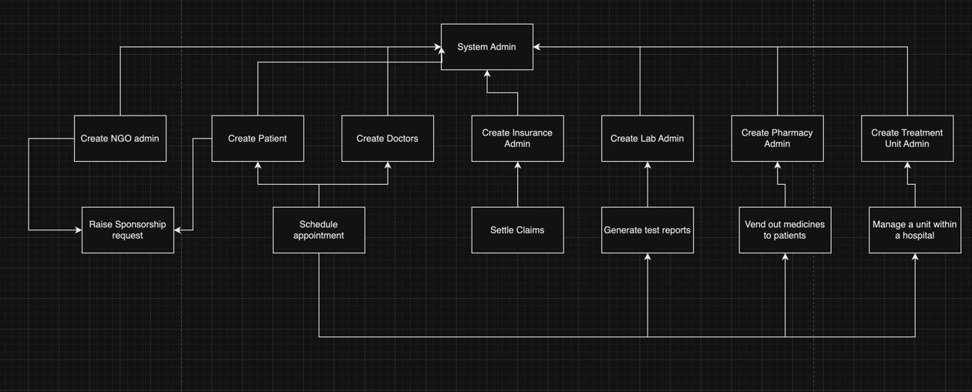
design

Slide 7
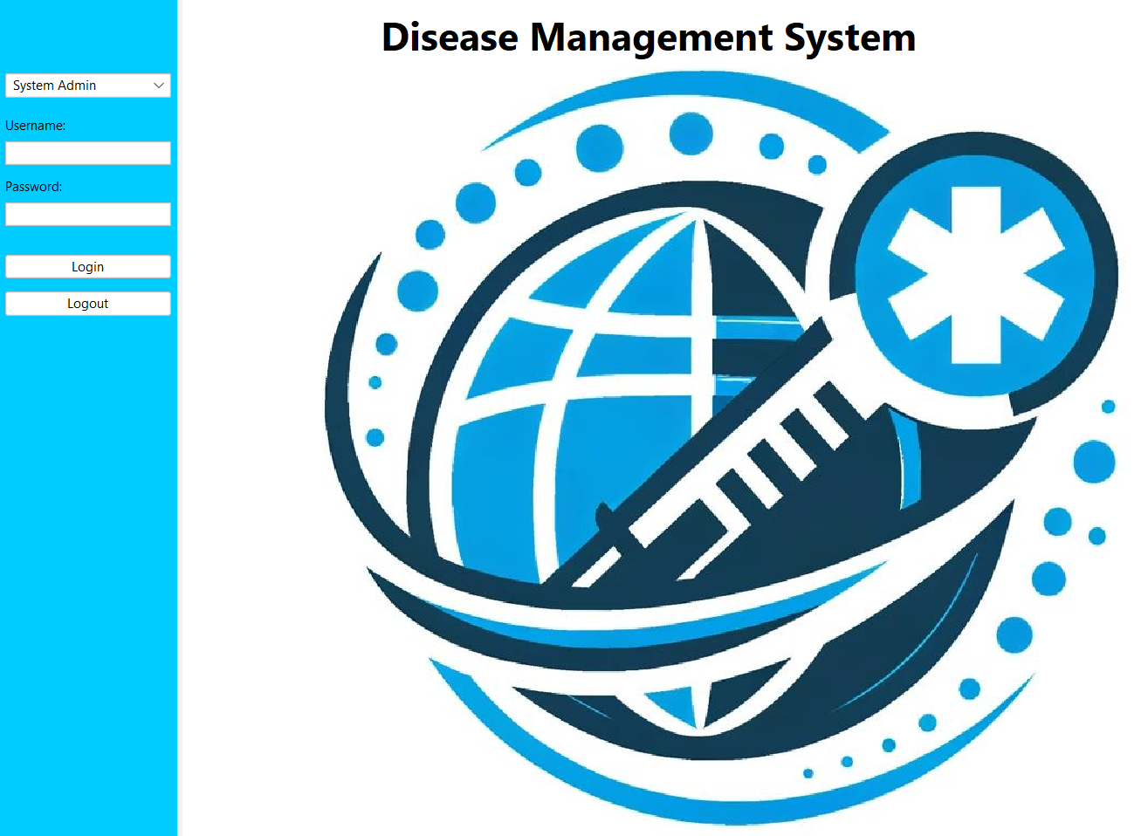
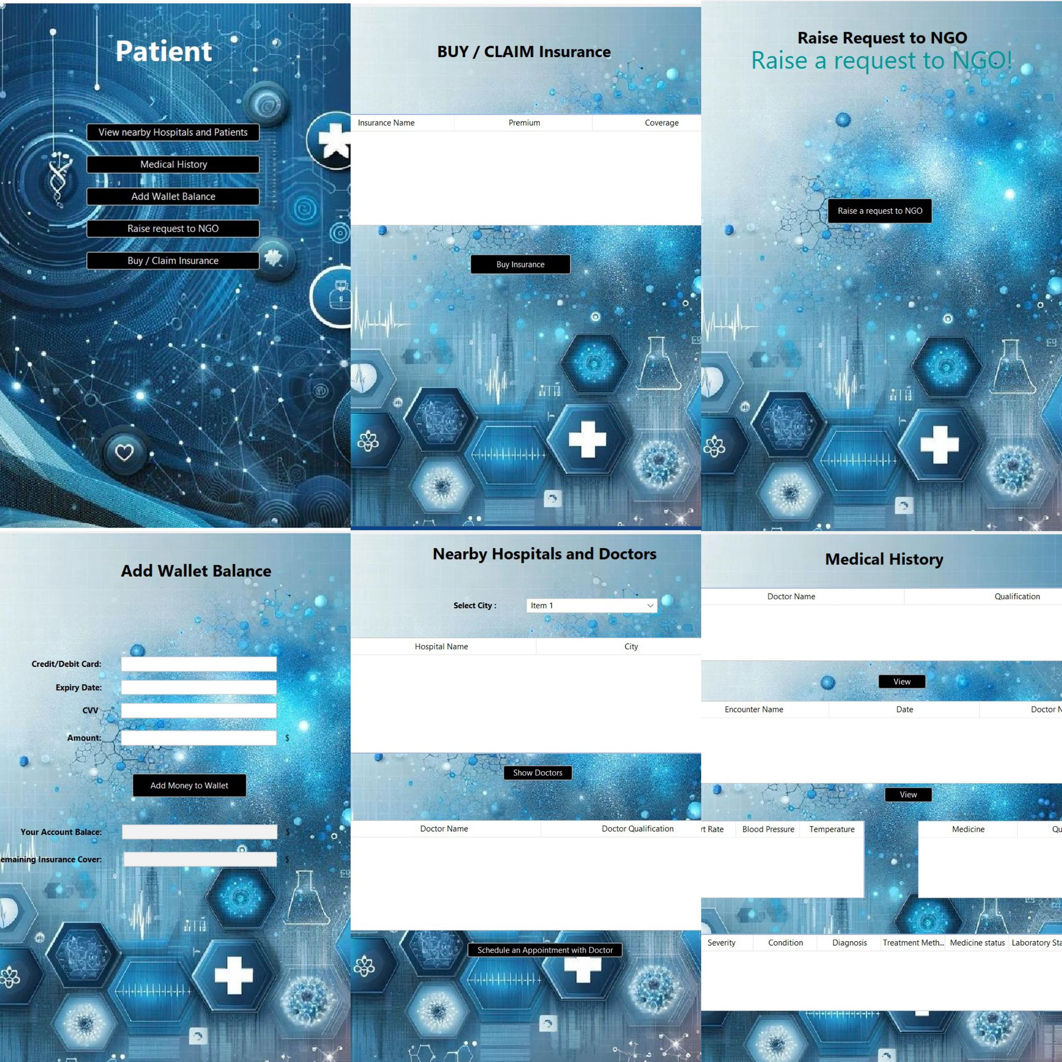
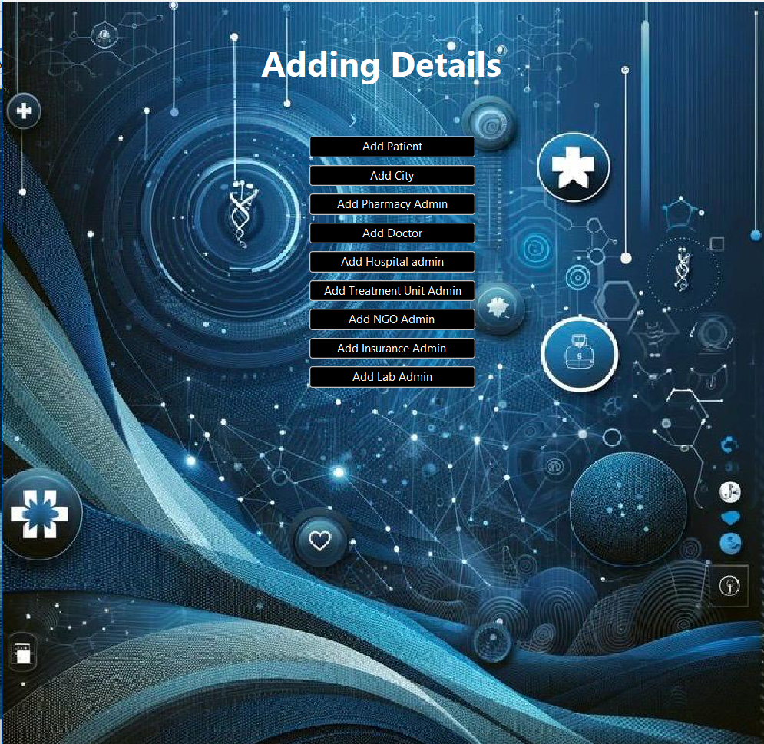
Implementation
Patient Dashboard and its details
LogIn Page
Landing Page
For System Admin

Slide 8
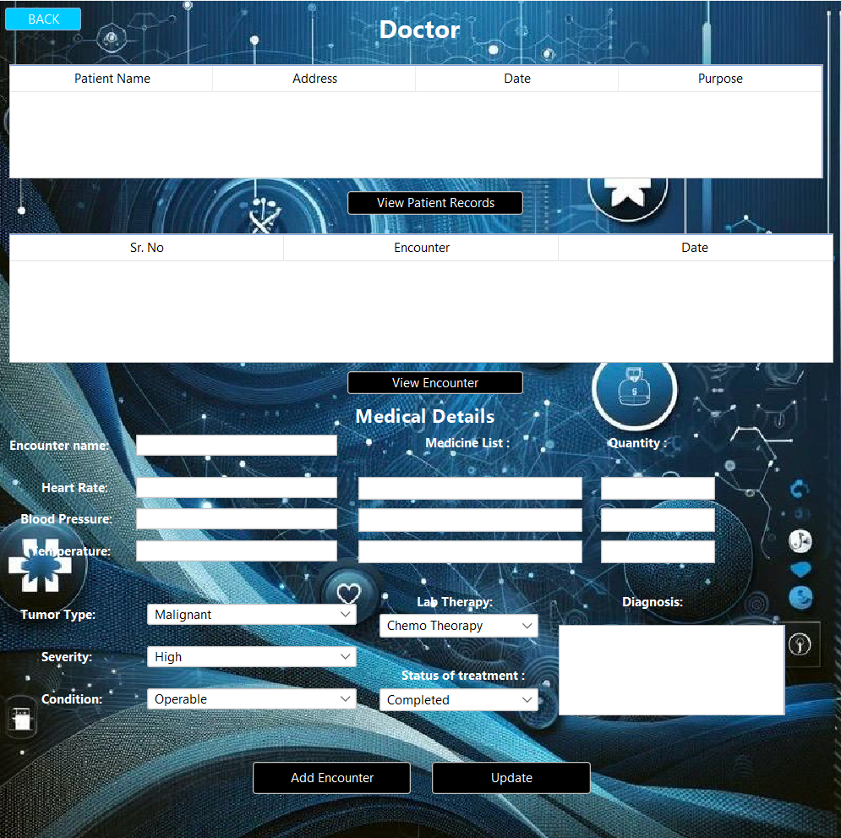
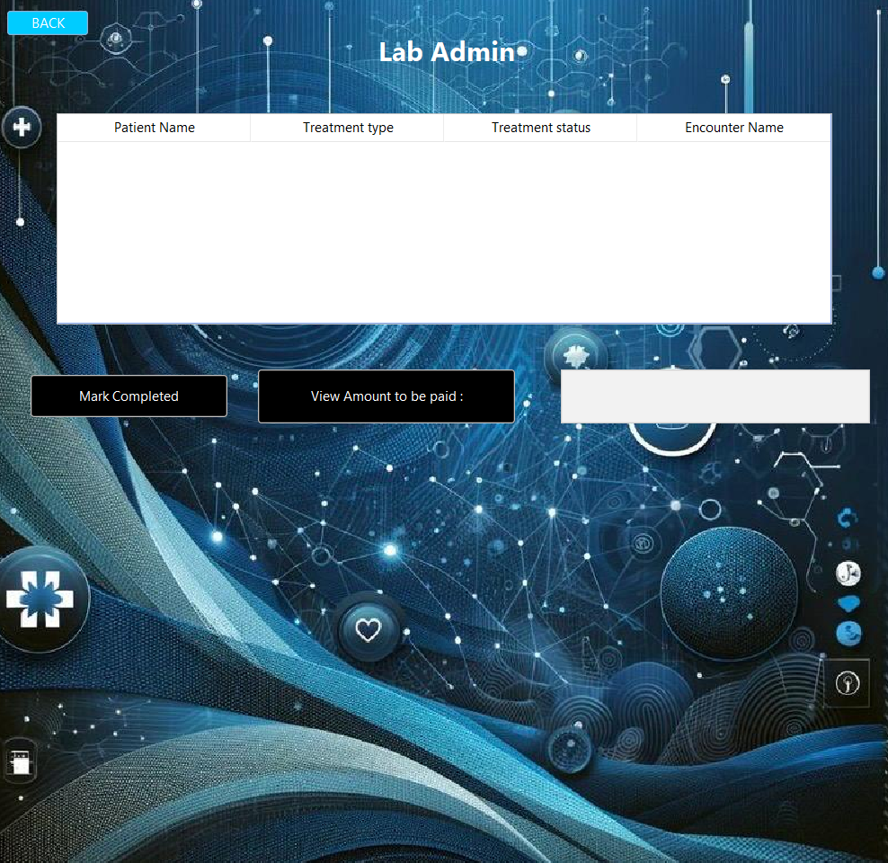
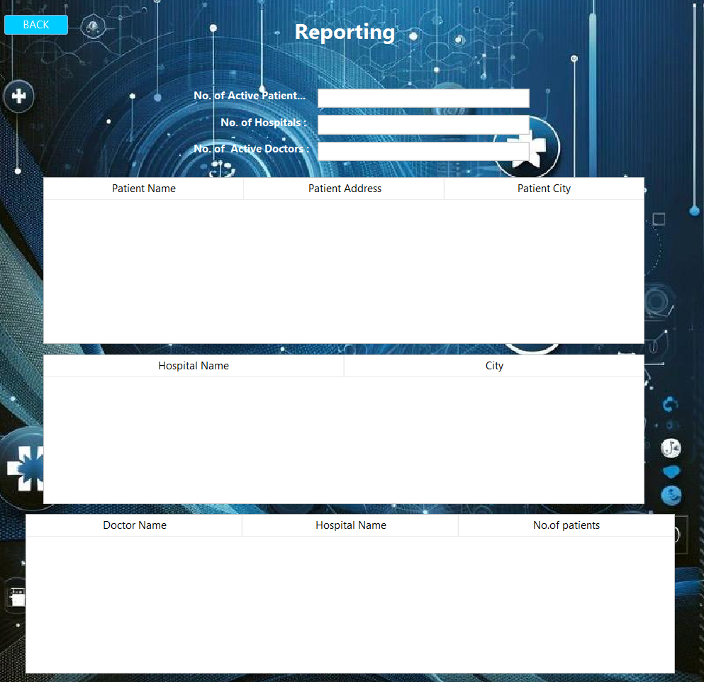
Implementation
Lab Admin Dashboard
Doctor
Dashboard
Reporting Dashboard

Slide 9
result
The Disease Management System transforms healthcare with an integrated platform led by the System Admin.
Patient-centric features empower individuals to access information, engage with providers, and manage records.
Streamlined workflows and specialized dashboards enhance treatment coordination.
Report monitoring ensures strategic decision-making, and transparent financial transactions via Insurance Admin and Pharmacy Dashboards contribute to an integrated healthcare environment.
The system optimizes patient care and underscores the importance of integrated systems in advancing health outcomes.

